Slide 1

TITLE-SLIDE PUZZLE SUBMITTED BY- Name-Shubhi Agarwal Roll_no-23696622 Email id : shubhi.ag09@gmail.com SUBMITTED TO- Name-Mr. Apurv Gupta(IP Teacher)
BETHANY CONVENT SCHOOL

Slide 2
About project:
A puzzle is a game, problem, or toy that tests a person's ingenuity or knowledge. In a puzzle, the solver is expected to put pieces together in a logical way, in order to arrive at the correct or fun solution of the puzzle. There are different genres of puzzles, such as crossword puzzles, word-search puzzles, number puzzles, relational puzzles, or logic puzzles.
Sliding puzzles are essentially two-dimensional in nature, even if the sliding is facilitated by mechanically interlinked pieces (like partially encaged marbles) or three-dimensional tokens. As this example shows, some sliding puzzles are mechanical puzzles. However, the mechanical fixtures are usually not essential to these puzzles; the parts could as well be tokens on a flat board that are moved according to certain rules.

Slide 3
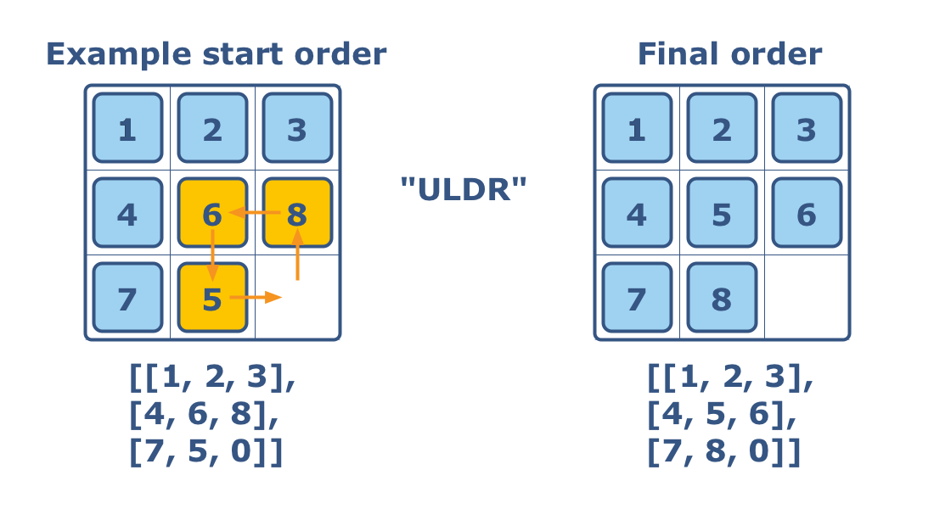
For example:

Slide 4
Project:
MODULE :
In My project there are three modules.
first module : Game
Second module : game_1
Third module : game_2
fourth module : game_3
in those modules RANDOM function is use to generate random no In boxes.
All the randomly generated no’s are put in a list a list.
in those module there are two functions:
First is game() function which display the board of game and game is ready to play.
Second function() is win(),this function check the winning combination and ends the game.

Slide 5
In game there are boxes which have random no. player has to choose box no to move the box not the no which are display on the box.
For example: if we want to move no 4 so we have to choose the box no that is 8 then box 8 is moved to the place of box 9 and box 9 take the place of box 8.
BOX_1 5 | BOX_2 7 | BOX_3 6
BOX_3 1 | BOX_5 8 | BOX_6 3
BOX_7 2 | BOX_8 4 | BOX_9 empty

Slide 6
Win conditions: 2X2 3X3 4X4
1 | 2
3
1 | 2 | 3
4 | 5 | 6
7 | 8 | empty
1 | 2 | 3 | 4
5 | 6 | 7 | 8
9 | 10 | 11 | 12
13 | 14 | 15 | empty

Slide 7
THANK YOU

